Slide 1


Covid19 Tweet Analysis
By Arnold Ighiwiyisi

Slide 2
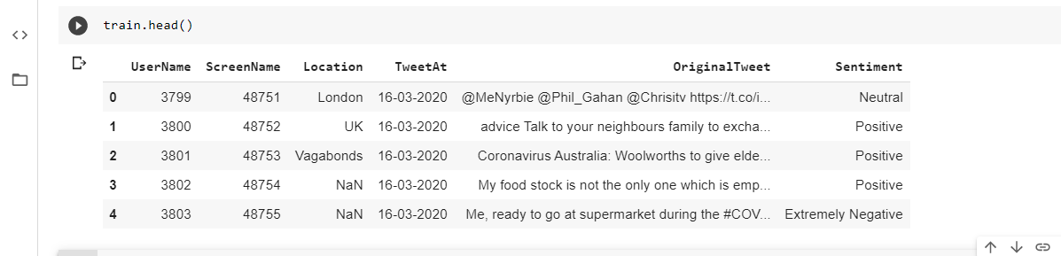
Covid19 Tweet Analysis
Original Dataset
Covid19 Tweet Analysis
Covid19 Tweet Analysis
6 columns
41157 rows

Slide 3
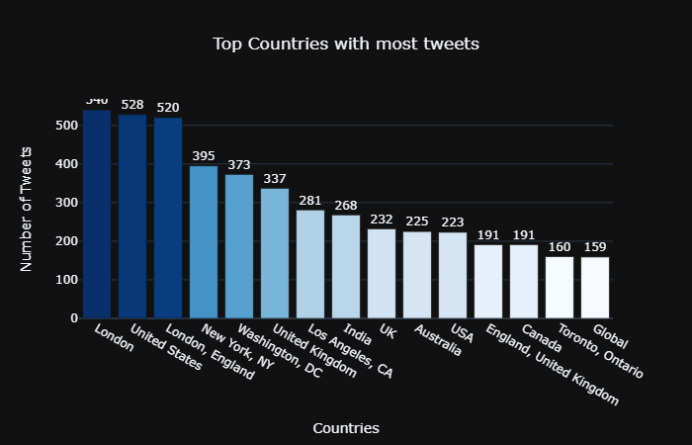
Data Visualisation

Slide 4
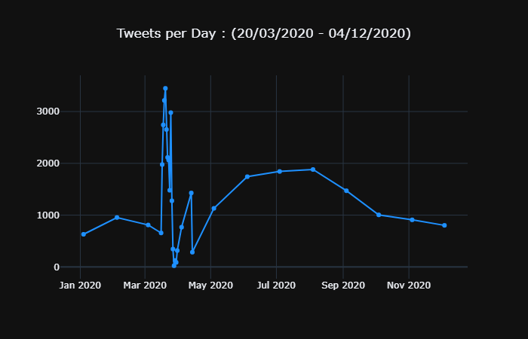
Data Visualisation

Slide 5
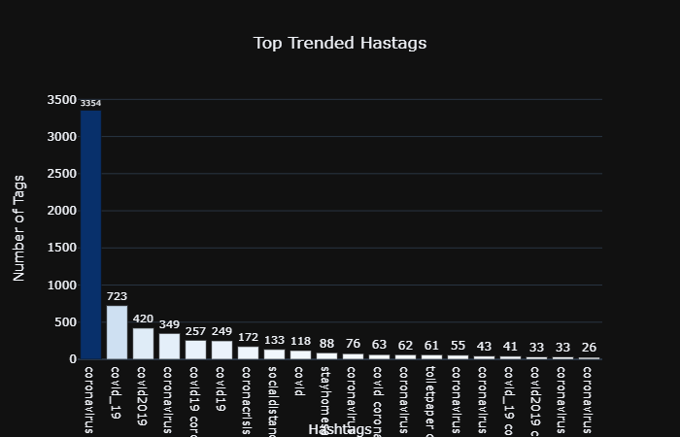
Data Visualisation

Slide 6
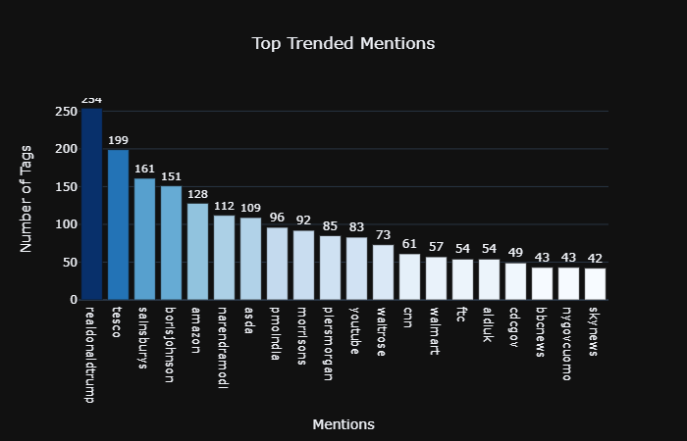
Data Visualisation

Slide 7
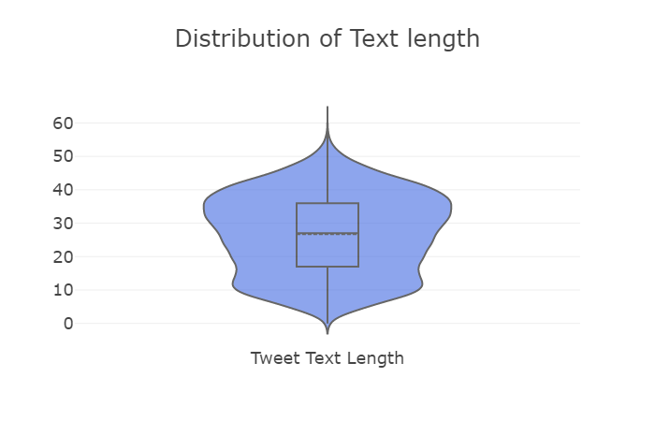
Data Visualisation

Slide 8
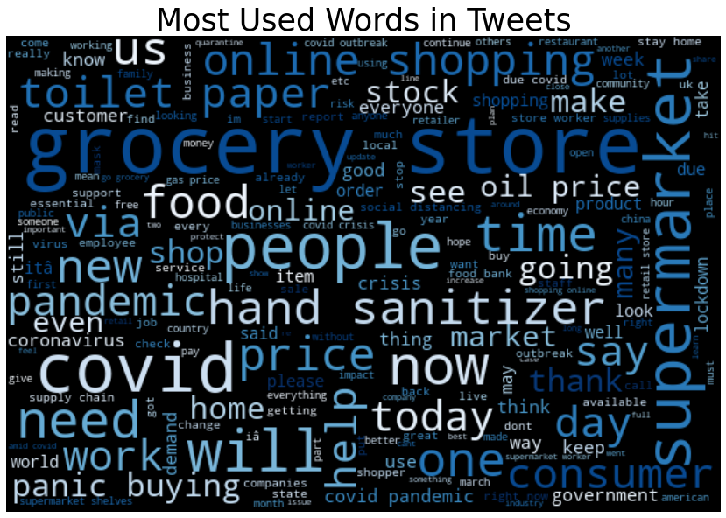
Word Cloud: Most Used words

Slide 9
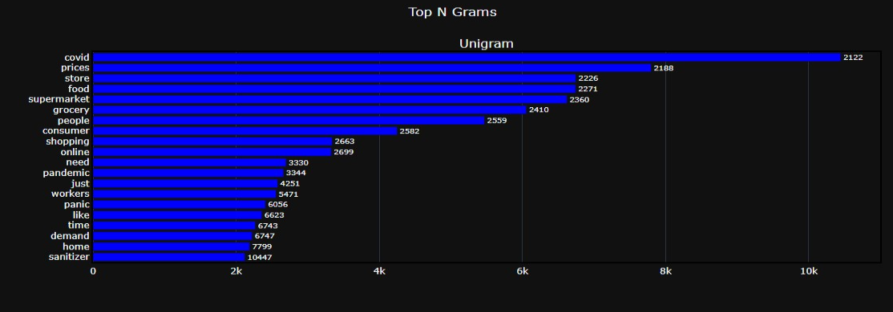
Unigram: Most used single words

Slide 10
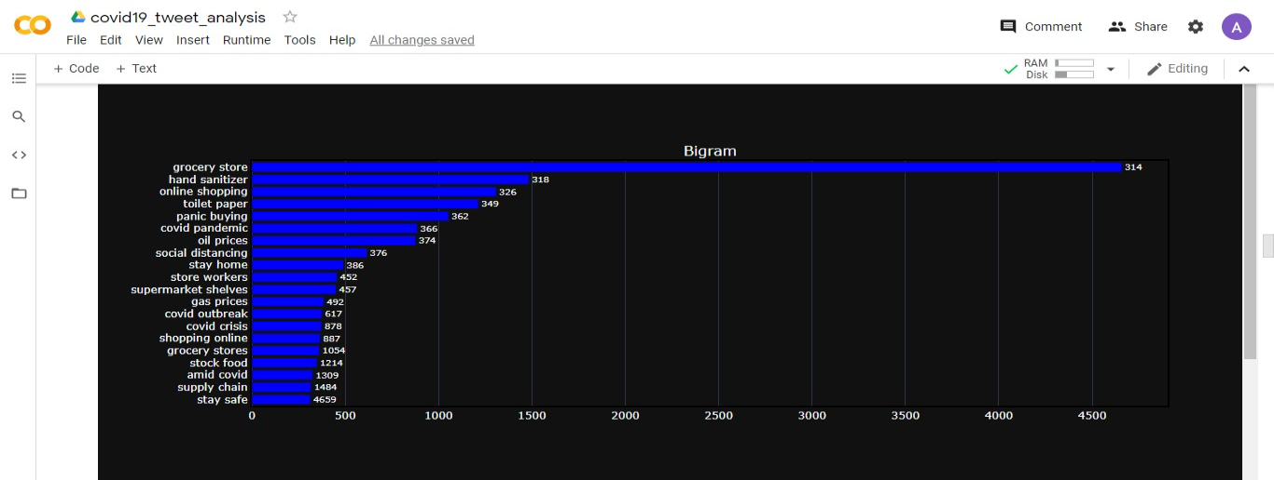
Bigram: Most used two words

Slide 11
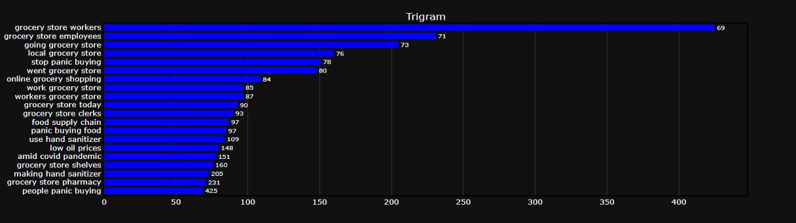
Trigram: Most used three words

Slide 12
Summary
The Most single word “covid”, “prices” and “store”
The most used two words “grocery store”, “hand sanitizer” and “online shopping”
The most three words “grocery store workers”, “grocery store employees” and “going grocery store”

Slide 13
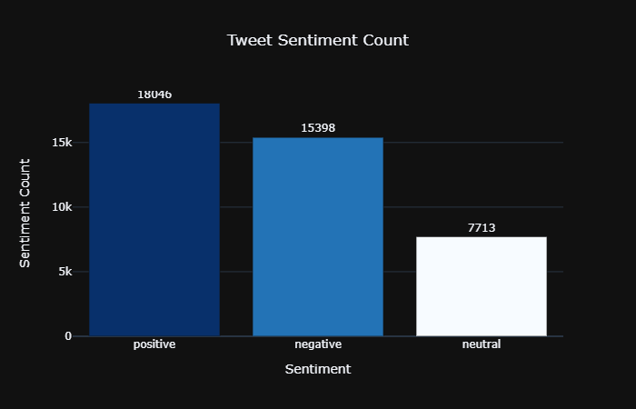
Class Label Ditribution

Slide 14
Modelling
Logistic Regression
Preprocessed tweet_sentiment columns
Reduced class label to 3: positive, negative and neutral
Used two columns for modelling: text and labels columns
TF-IDF vectoriser
Max_features = 50000
Ngram_range = (1, 2)

Slide 15
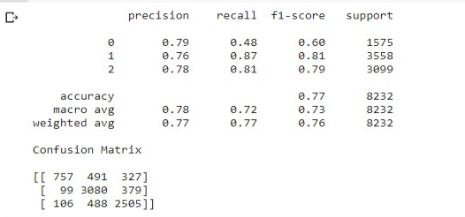
Logistic Regression Performnace

Slide 16
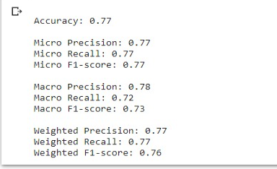
Logistic Regression Performnace

Slide 17
Tensorflow LSTM
Max_Nb_Words ⇒ 50000
Max_Sequnce_Length ⇒ 300
Embedding_dim = 100
Preprocessing ⇒ OneHotEncoding and Labelencoder
3 Dense Sequential Layers
100 LSTM Layer
20% dropout
Optimizer ⇒ Adam Optimizer
Loss ⇒ Categorical cross entropy
Epoch ⇒ 5
Batch_size ⇒ 64

Slide 18
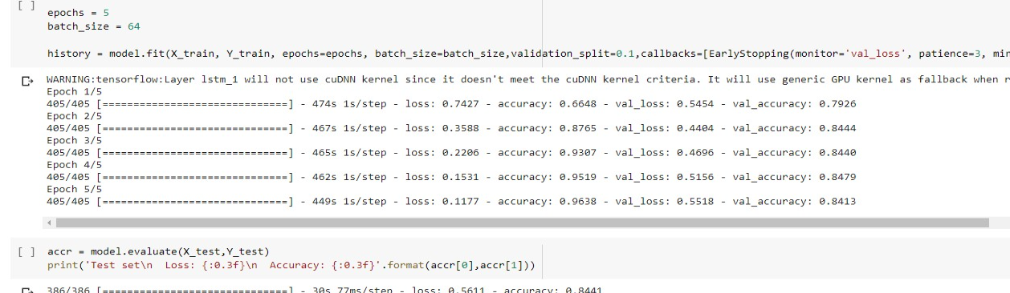
LSTM Performance

Slide 19


